Slide 1
Chat Application using Sockets

Slide 2
Swing
Swing Java consists of Look and feel Accessibility Java 2D Drag and Drop, etc
Swing, which is an extension library to the AWT, includes new and improved components that enhance the look and functionality of GUIs.
Swing can be used to build Standalone swing gui Apps as well as Servlets and Applets.
It employs a model/view design architecture. Swing is more portable and more flexible than AWT.

Slide 3
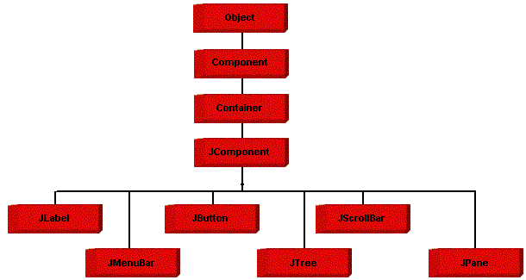
Swing Hierarchy

Slide 4
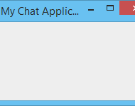
JFrame
public class ui{
public static void main( String args[] ) {
JFrame win = new JFrame( "My Chat Application" );
win.setDefaultCloseOperation( JFrame.EXIT_ON_CLOSE );
win.setSize(new Dimension( 250, 150 ));
win.setVisible(true);
}
}

Slide 5

JPanel
public class ui {
public static void main( String args[] ) {
JFrame win = new JFrame( "My Chat Application" );
JPanel panel = new Jpanel();
win.add(panel):
}
}

Slide 6
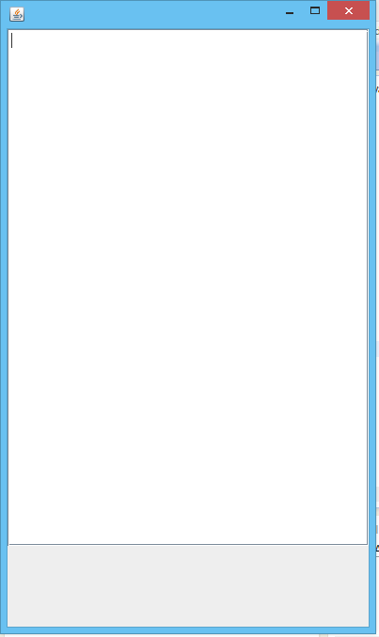
JTextPane
public static void main(String args[])
{
JTextPane msg=new JTextPane();
msg_view.setPreferredSize(new Dimension(40,400));
JScrollPane sp=new JScrollPane(msg_view);
panel.add(sp,BorderLayout.NORTH);
frame.add(panel,BorderLayout.NORTH);
}

Slide 7
Adding Styles to text
To differentiate user1 and user2 text from each other.
Let us give colors to user’s text separately.
Style style = msg_view.addStyle("I'm a Style", null); StyleConstants.setForeground(style, Color.blue);

Slide 8
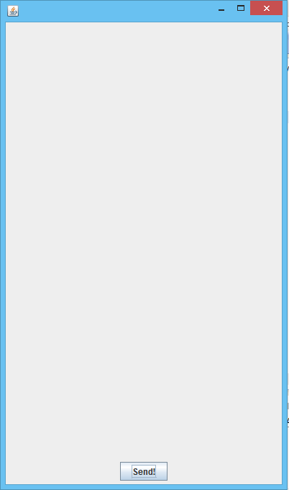
JButton
public static void main(String args[])
{
send=new JButton("Send!");
panel2.add(send);
frame.add(panel2,BorderLayout.SOUTH);
}

Slide 9
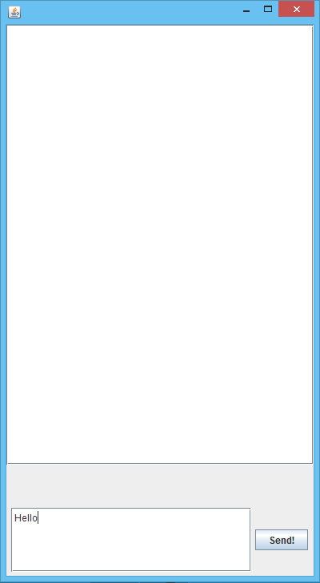
Chat Window

Slide 10
Sending and Receiving messages
Both users must be able to send and receive messages.
Receiving must be done continuously
Sending must be done as an action of button “send!”click

Slide 11
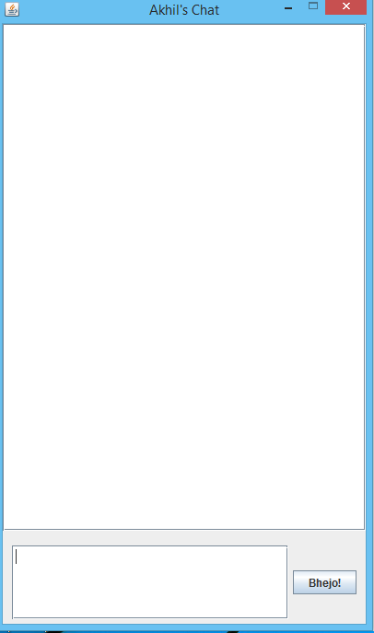
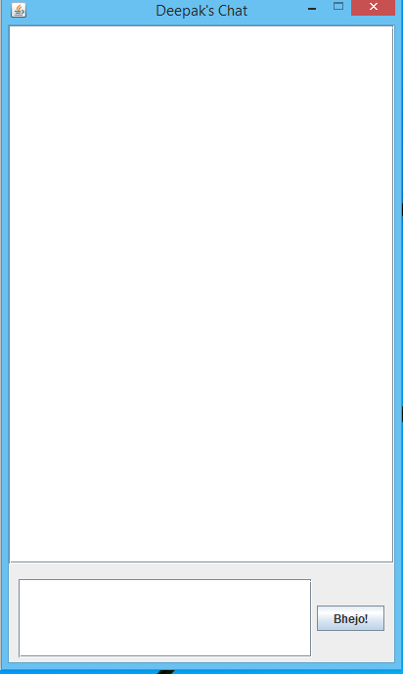

Slide 12
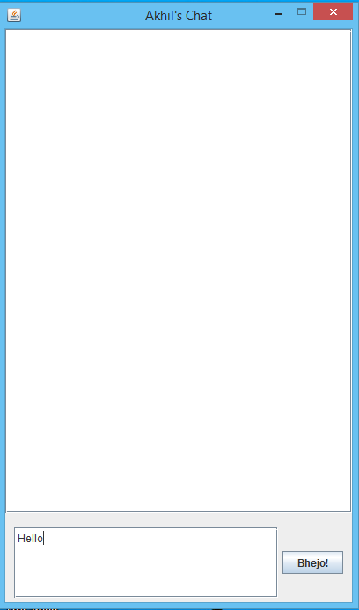
Sending message

Slide 13
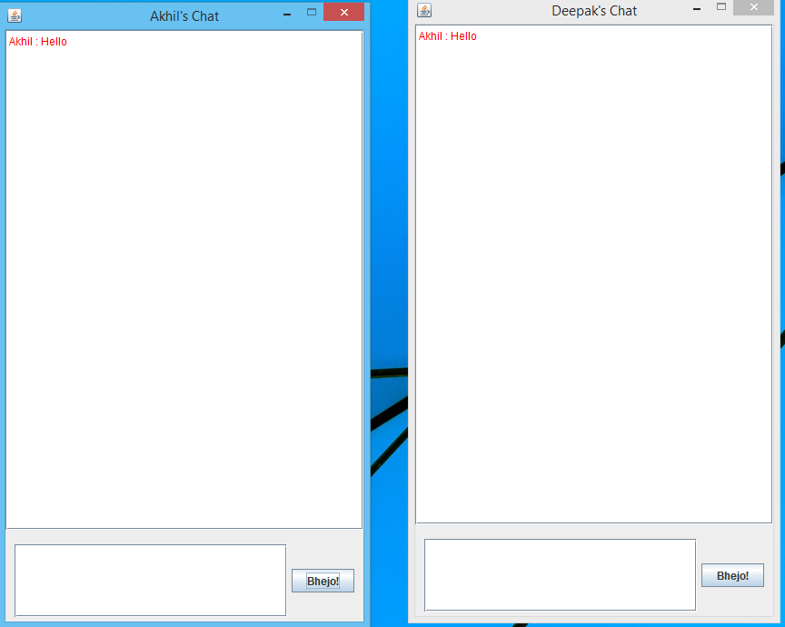
Message sent from
Akhil
to
Deepak

Slide 14
